Slide 1

Automated Irrigation system Applied in Crop Farming
(ITC’s Green House)
Lecturer : HEL CHANTHON
Student : PROEUNG BUNRONG (e20191346)
Department : I3 GTR

Slide 2
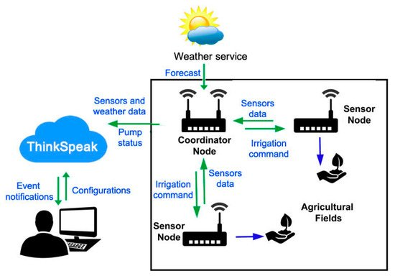
Project analysis slide 4
Project Analysis
The Composition of the system
The system is composed mainly of three parts:
Cloud Platform, Coordinator Node, and Sensor Nodes …

Slide 3
Project analysis slide 10
Project Analysis
Planning for first month
Week 1 6 Aug – 13 Aug | Week2 14 Aug – 20 Aug | Week3 21 Aug – 27 Aug | Week4 28 Aug – 3 Sep
Researching Code and test with dht11 Create charnel Thingspeak and testing. | To understand problem of code, Using Wi-Fi with username Combine code with coordinator and testing then send data to Thingspeak. | Collect data from Greenhouse send to Thingspeak And show all the result of Temperature (T1+T2) Or another Sensor on thingspeak. | Need to Complete planning of first month and continue working for second month to use Camera in greenhouse.
Missing: testing some error, problem to understand something in code | Not ready combine code with coordinator yet.

Slide 4
Project analysis slide 10
Project Analysis
Problems and solutions
ESP8266: Poor performance at hot place.
Code has corrected and Decide to combine with coordinator code.
Can’t make code to connect with username of WIFI yet.

Slide 5
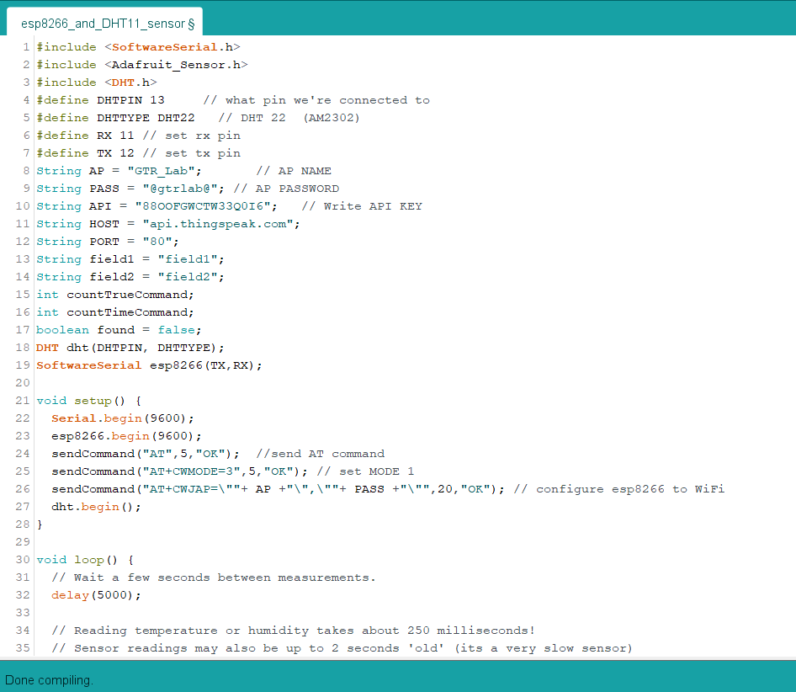
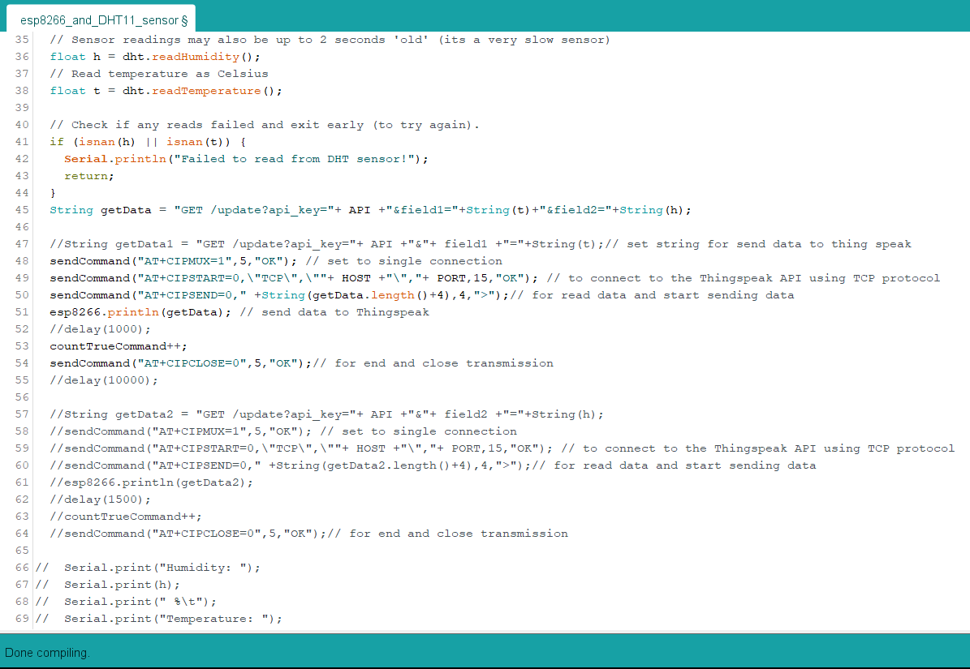
Project analysis slide 3
Project Analysis
Testing code with DHT11

Slide 6
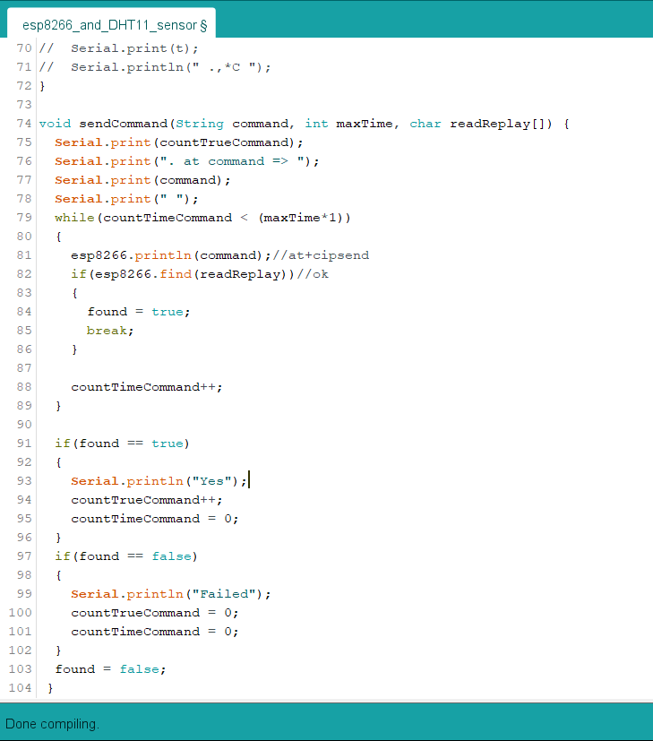
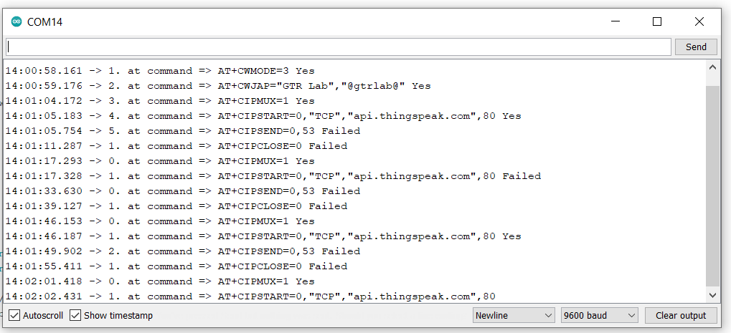
Project analysis slide 3
Project Analysis

Slide 7
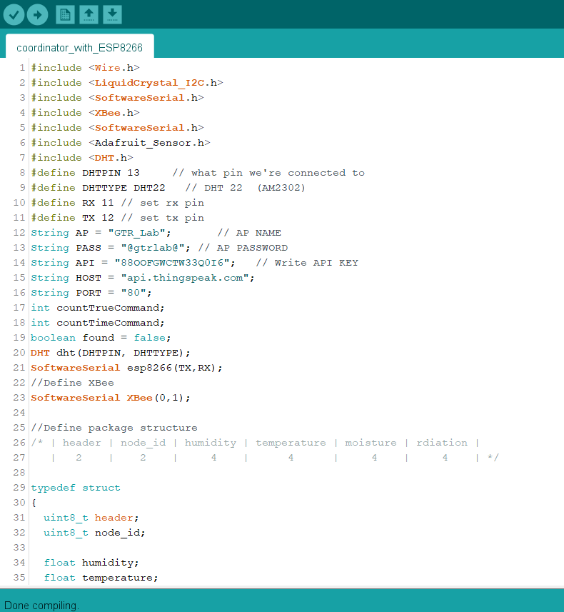
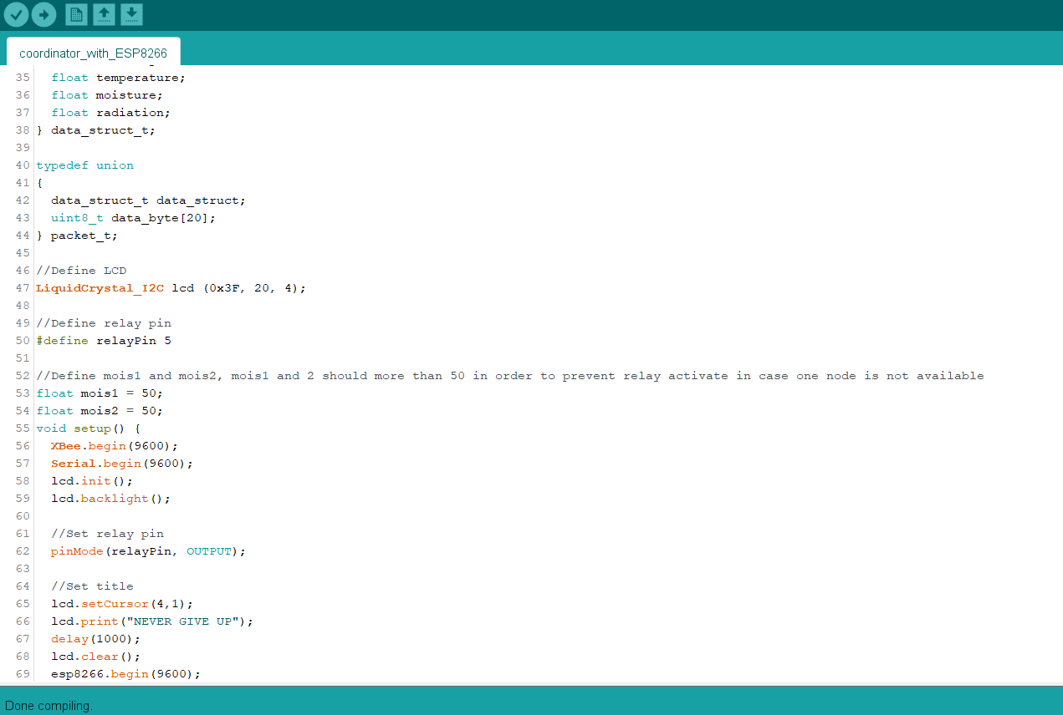
Project analysis slide 3
Project Analysis
Combine Code not ready yet

Slide 8
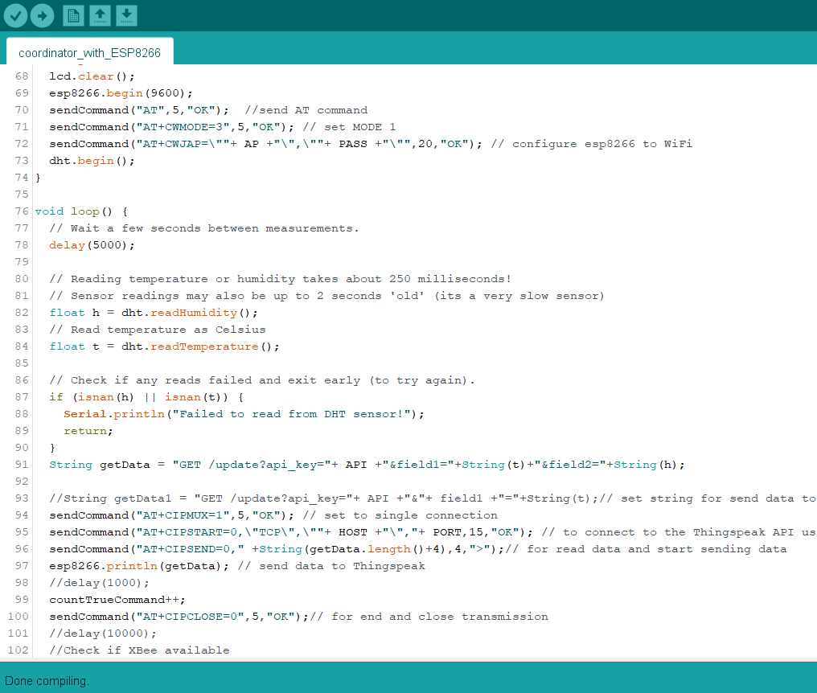
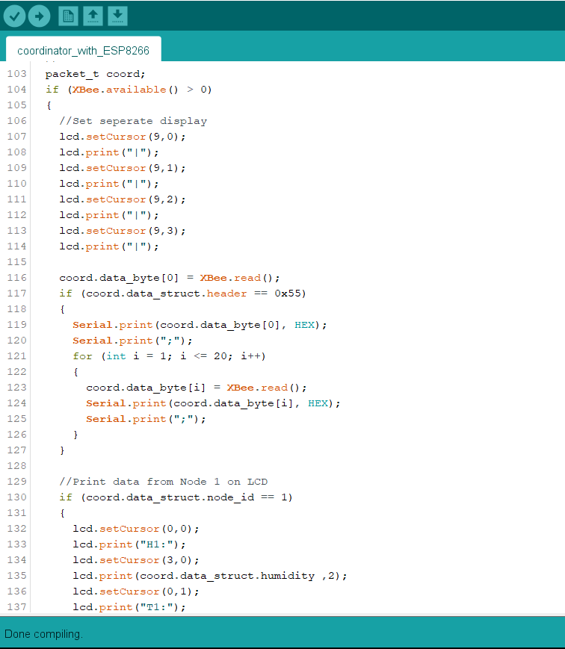
Project analysis slide 3
Project Analysis

Slide 9
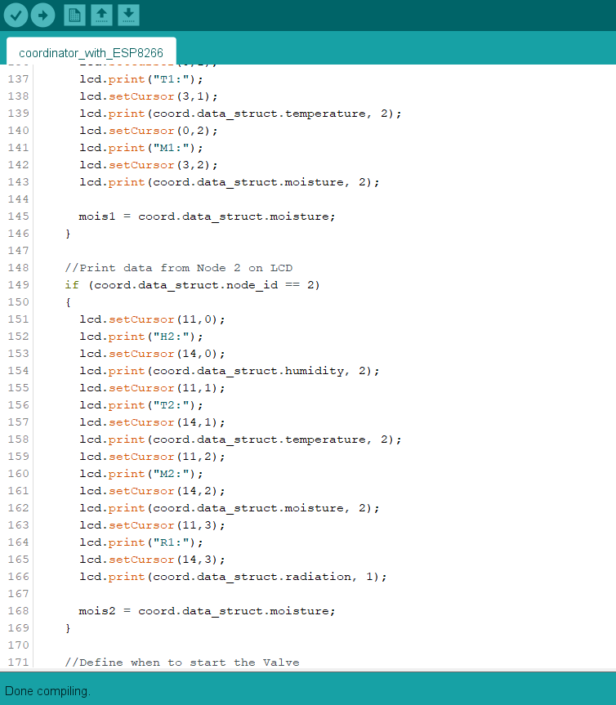


Project analysis slide 3
Project Analysis

Slide 10
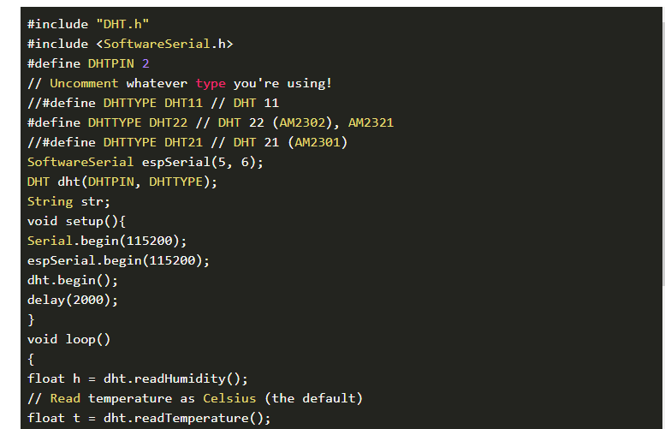
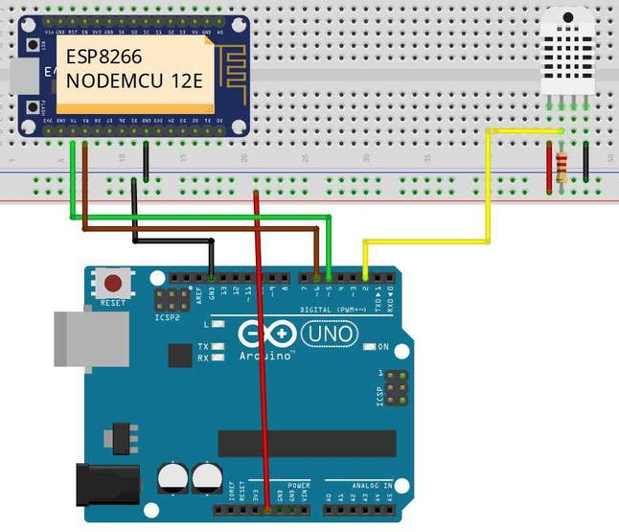
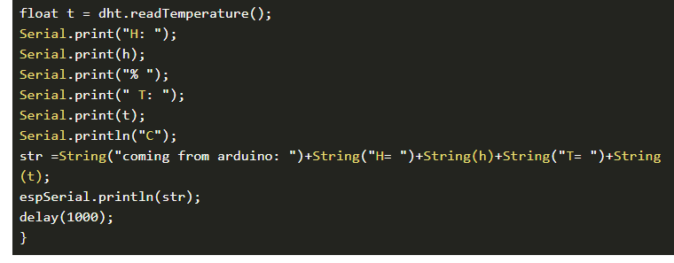
Project analysis slide 3
Project Analysis
Send Data from Arduino to ESP8266 NodeMCU
Code for Arduino:
Select Arduino Board and Arduino Port before uploading the code.

Slide 11
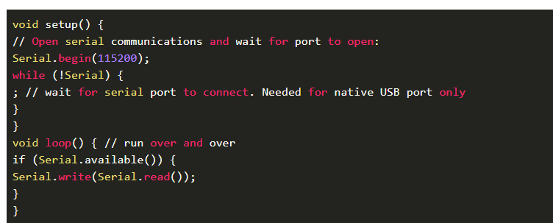
Project analysis slide 3
Project Analysis
Code for ESP8266:
Select NodeMCU 1.0 Board and ESP8266 Port before uploading the code.

Slide 12
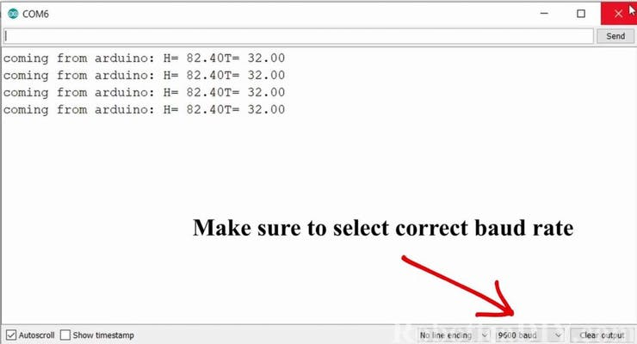
Project analysis slide 7
Project Analysis
Result

Slide 13
Thank You

